Slide 1

THE PHOENIX
MART

Slide 2
TEAM MEMBERS
Arju Adhikari
MD Ashif Ansari
Coordinator
Plant
Nimisha Raut
Sajil Maharjan
Specialist
Team Worker

Slide 3
01 Project Initiation
Project Charter
Meeting Minutes
02 Project Planning
Skills Audit
Project Management (MS Project)
Communication Tools Used
03 Project Execution
Database Design
Use Case Diagram
Logo Design
Wireframe
Requirement Catalogue
Product Development
Table
Of
Content

Slide 4
PROJECT INITIATION
Project Charter
Meeting Minutes

Slide 5



Project Charter
Roles
and
Responsibilities
Version
Control
Project
Scope
Project
Justification
Project
Assumption

Slide 6

MEETING MINUTES
SCHEDULE
AGENDA
LOCATION

Slide 7
PROJECT PLANNING
Belbin Analysis
Skill Audit
Ms Project
Communication Tools Used

Slide 8
BELBIN ANALYSIS
Arju Adhikari
Co-Ordinator, Shaper , Plant
Md Ashif Ansari
Nimisha Raut
Complete Finisher, Specialist, Team Worker
Sajil Maharjan
Team Worker, Monitor Evaluator, Shaper
Plant, Implementer, Resource Investigator

Slide 9
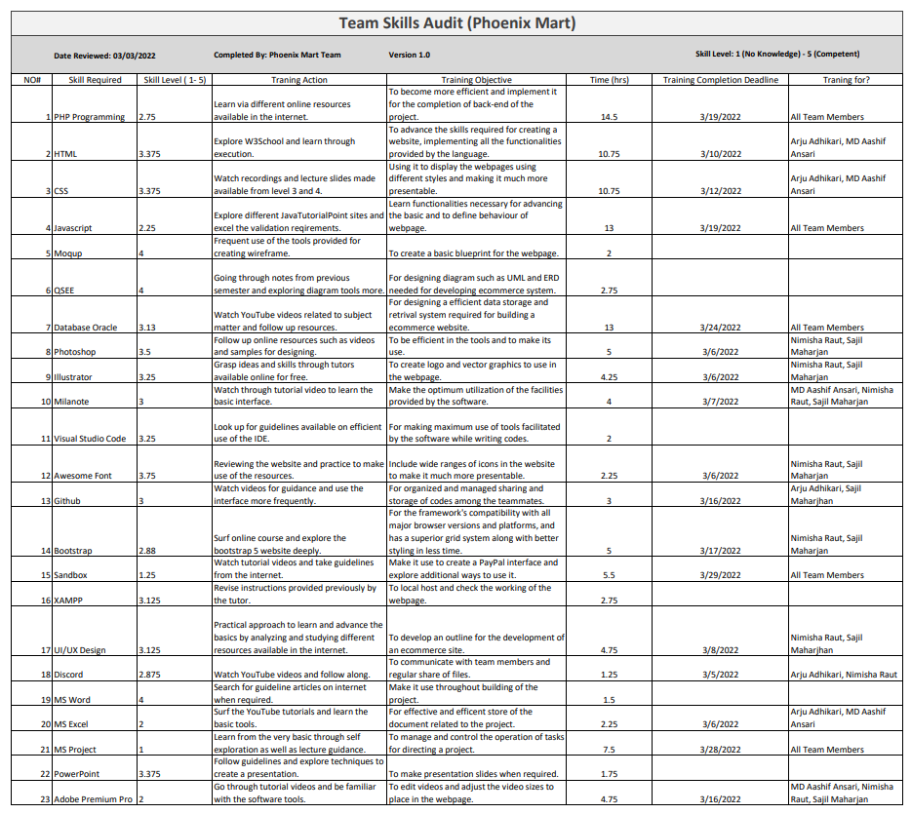
SKILL AUDIT

Slide 10
SKILL AUDIT
HTML & CSS
Oracle
Frontend
Backend
JavaScript
PHP
.
.

Slide 11





MS PROJECT
Task Sheet
GANTT CHART
Timeline
CALENDER
RESOURCE SHEET

Slide 12
COMMUNICATION TOOL
DISCORD
Github
Gmail

Slide 13
PROJECT EXECUTION
Database Design
Use Case Diagram
Logo Design
Wireframe
Requirement Catalogue
Product Development

Slide 14
Entity

Slide 15
EERD

Slide 17
ERD

Slide 19
De-composite

Slide 20
De-composite

Slide 22
Customer Use case

Slide 23
Customer Use case

Slide 24
Customer Use case

Slide 25
Customer Use case

Slide 27
Trader Use case

Slide 28
Trader Use case

Slide 29
Trader Use case

Slide 30
Trader Use case

Slide 31
Trader Use case

Slide 33
Admin Use case

Slide 34
Admin Use case

Slide 35
Admin Use case

Slide 36
Admin Use case

Slide 37
Admin Use case

Slide 38
Admin Use case

Slide 41


REQUIREMENT CATALOGUE
Non-Functional Requirement
Functional Requirement

Slide 42



MoSCoW
Must
Should
Could

Slide 43
Product
All products need details
Interface to navigate products.
Interface to add products in cart and wish list.
Reviewing and rating of products.

Slide 44
Customer
Registration form for new user.
Login form.
View and update profile.
Interface to view product.
Access to cart.
Interface to place order and view order details.

Slide 45
Trader
Registration form for new user.
Login form.
View and update profile.
Shop and product management.
Access to dashboard and report.

Slide 46
Admin
Login form in apex oracle.
Manage trader and user.
Reports.
Payment.

Slide 47
Non- Functional
Responsive.
Heritage reflection.
Password encryption.
Audit Table.

Slide 48



LOGO DESIGN
Logo - Black
Logo -White
Logo -Icon

Slide 49
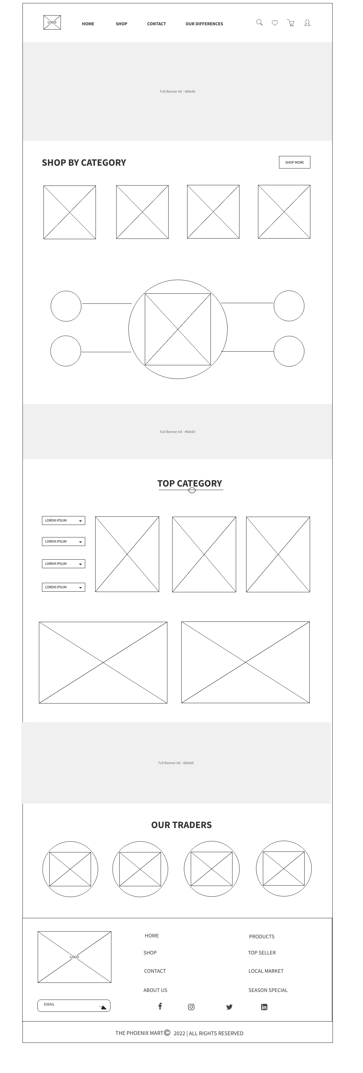
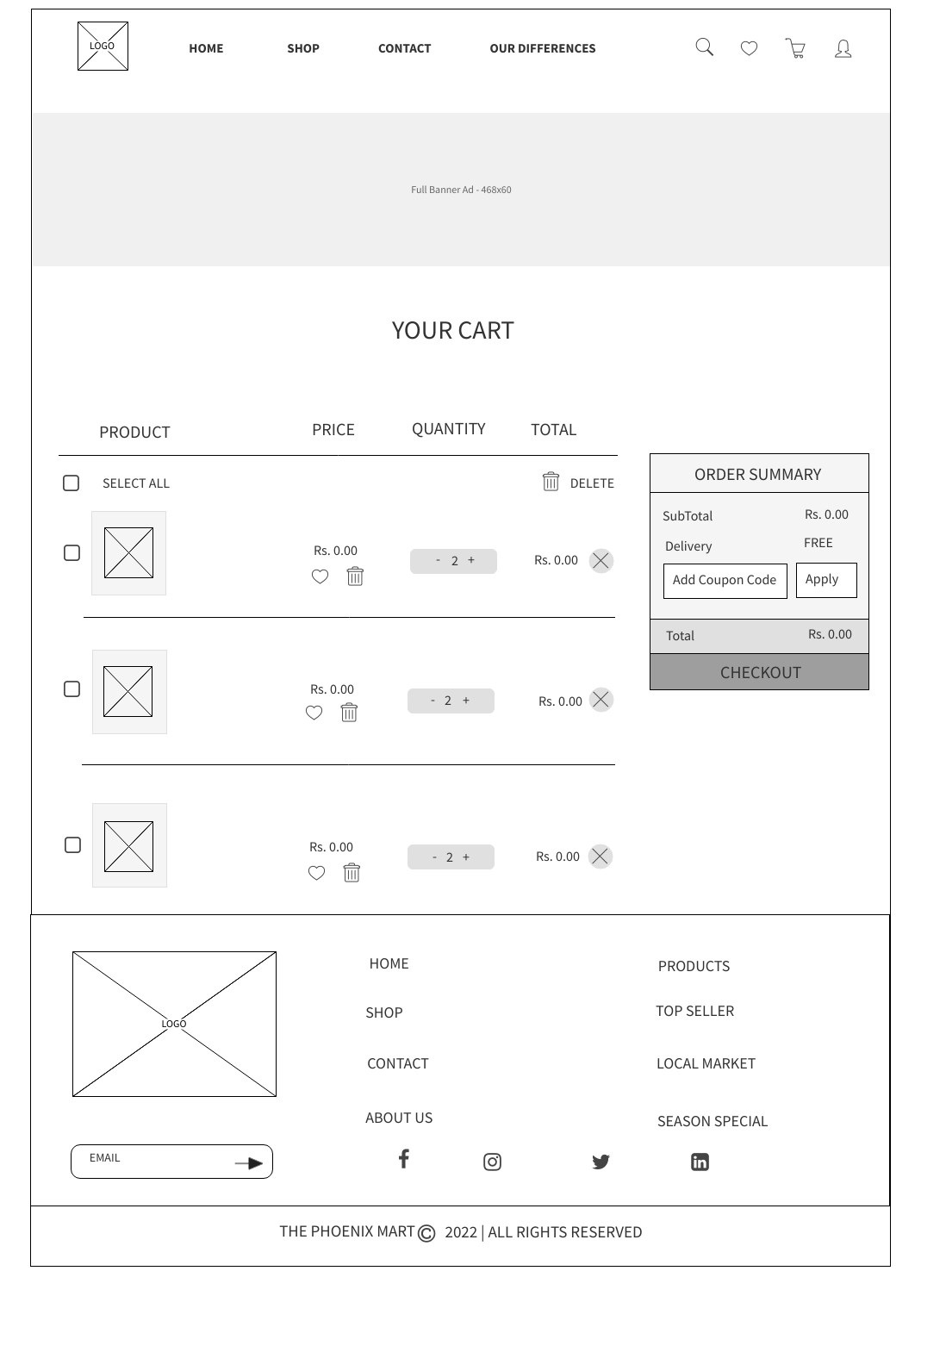
WIREFRAME DESIGN
Home Page
Cart Page

Slide 50
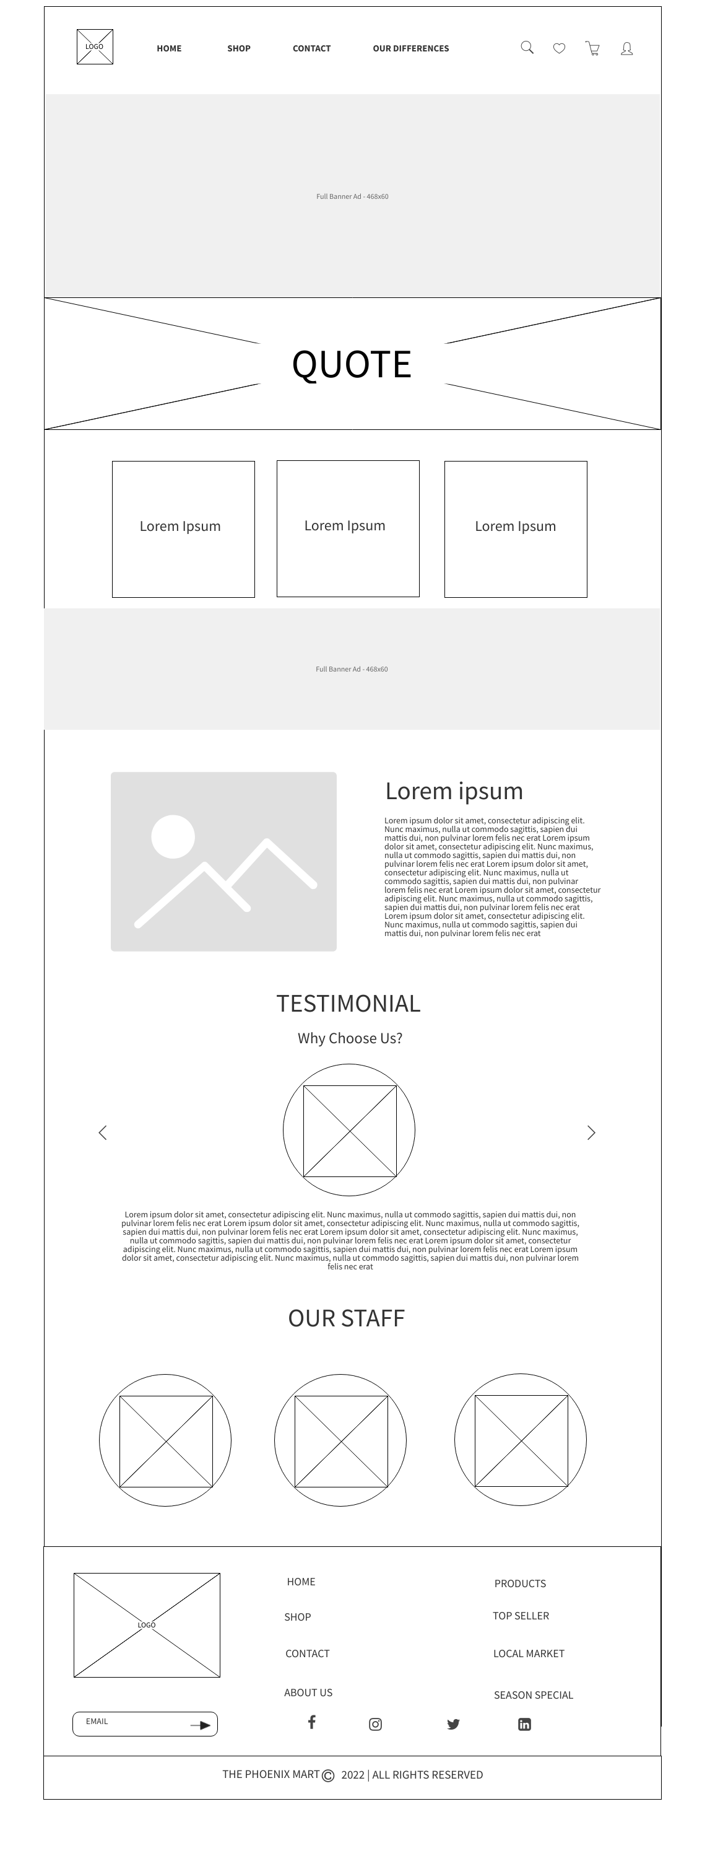
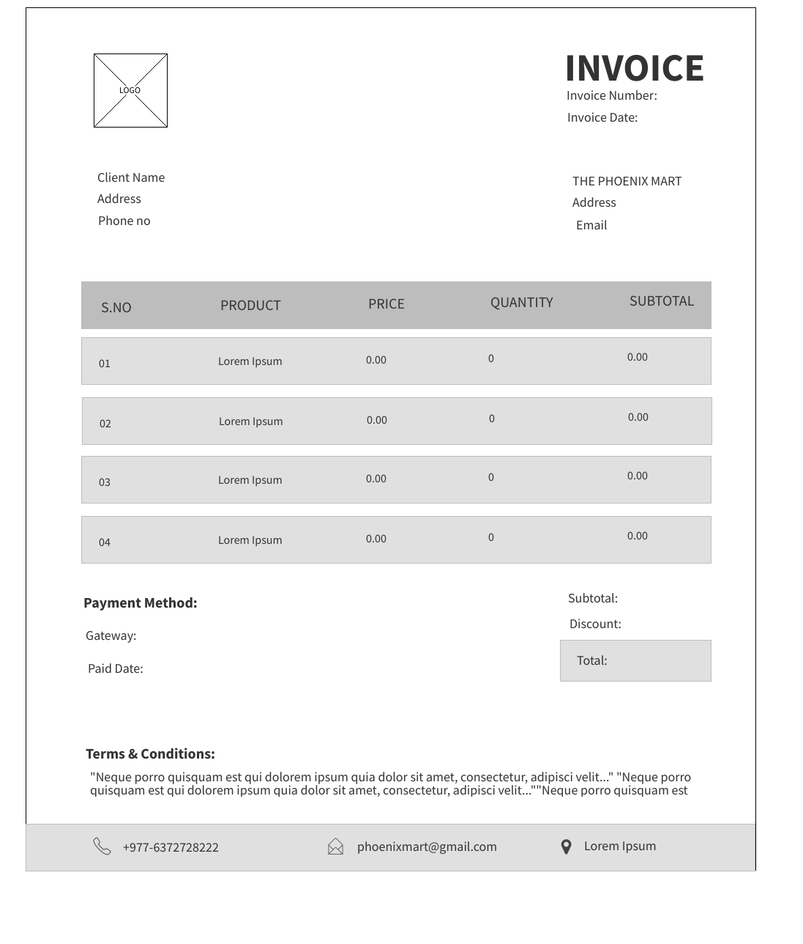
WIREFRAME DESIGN
About Us Page
Invoice

Slide 51
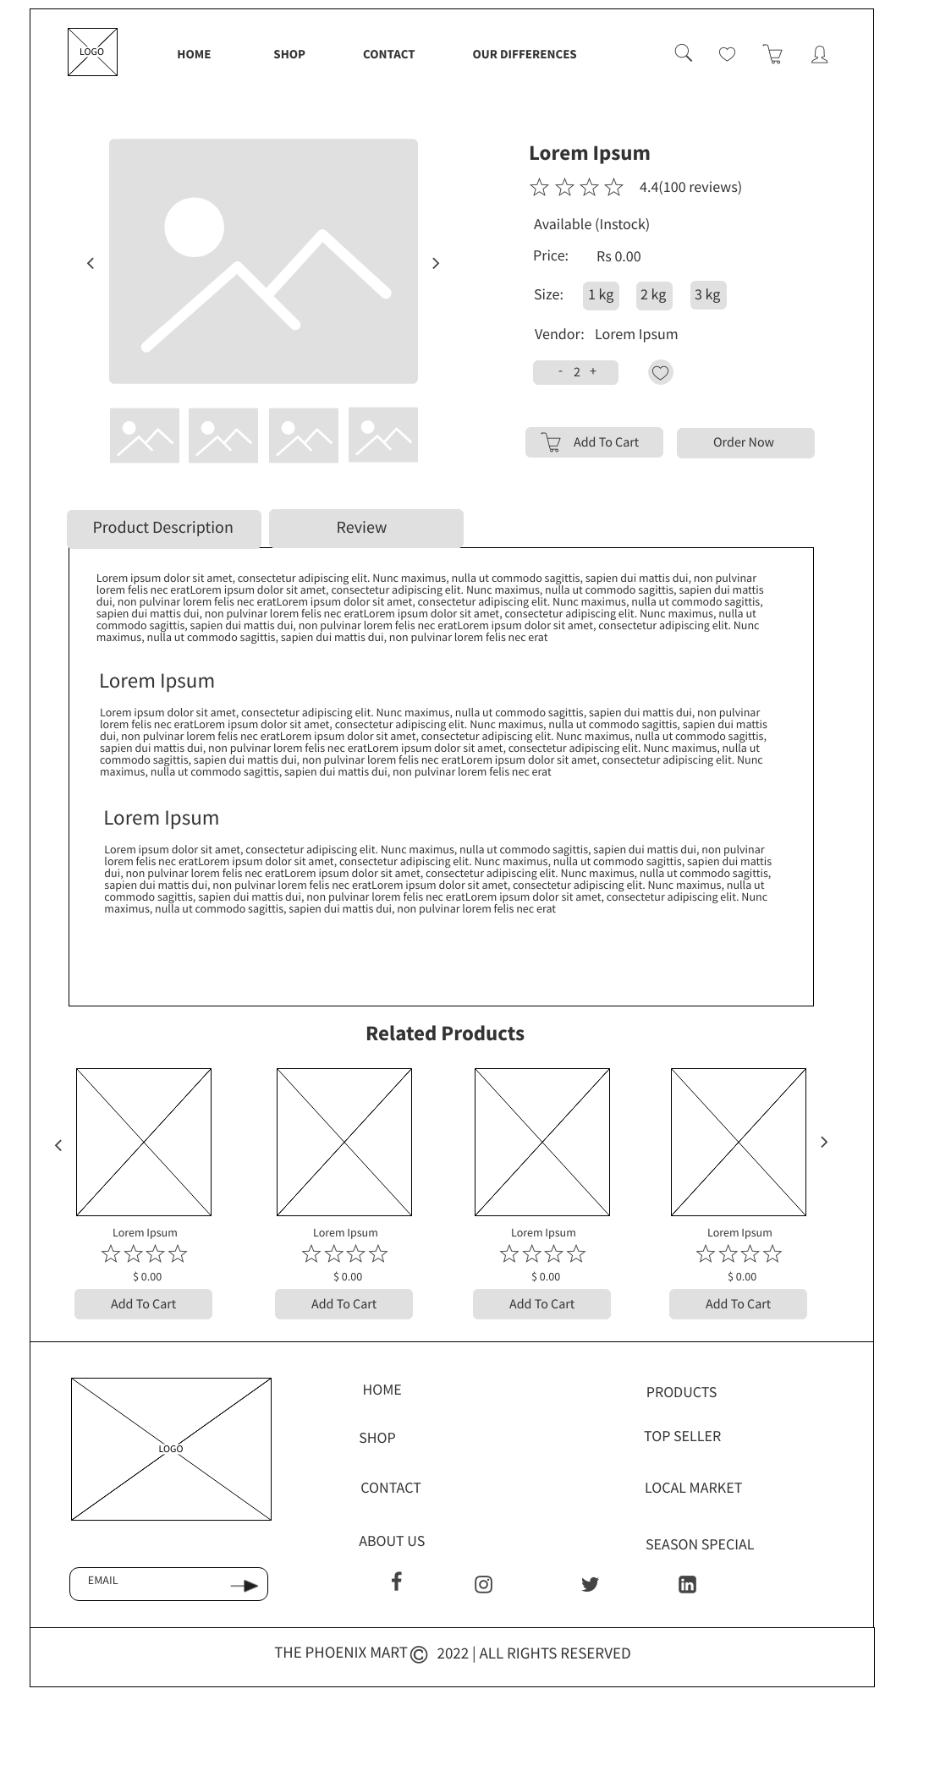
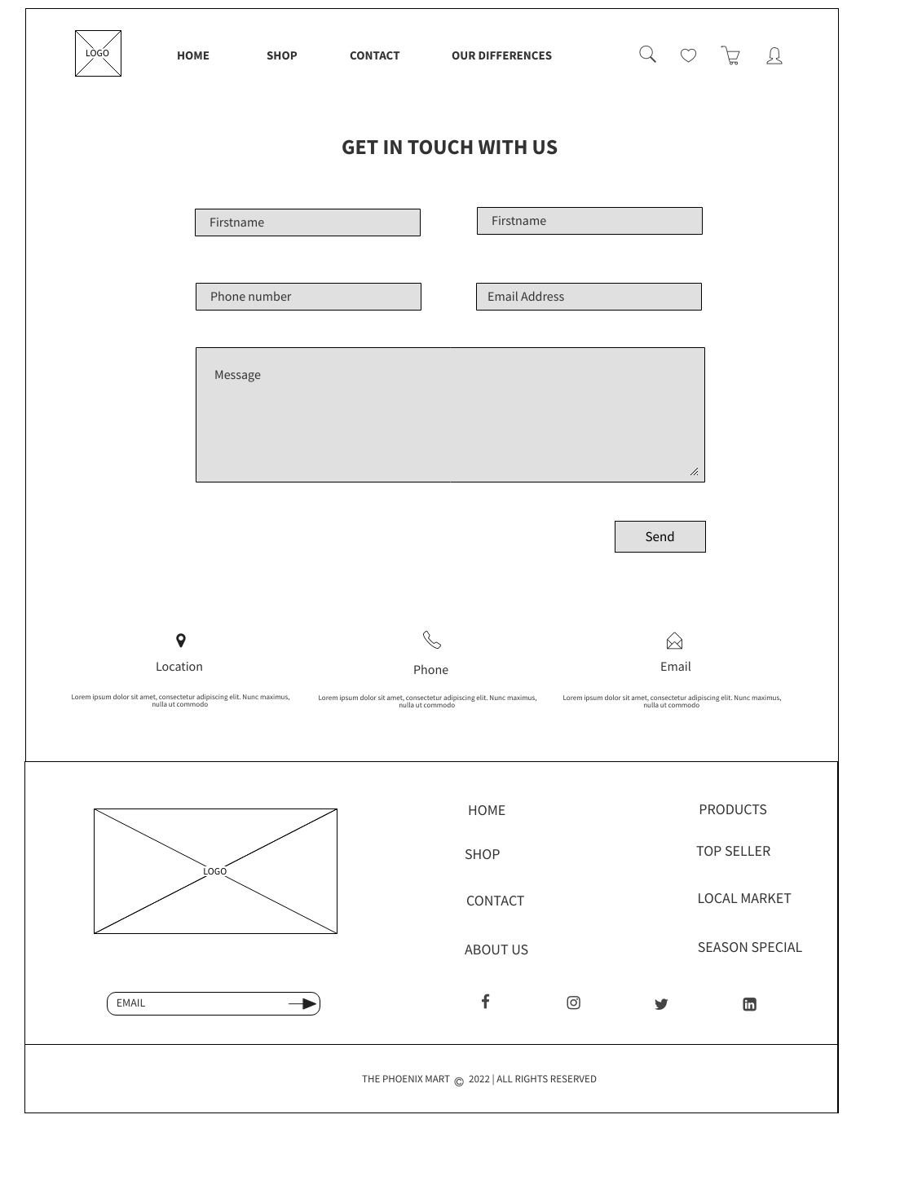
WIREFRAME DESIGN
Product Detail Page
Contact Page

Slide 52
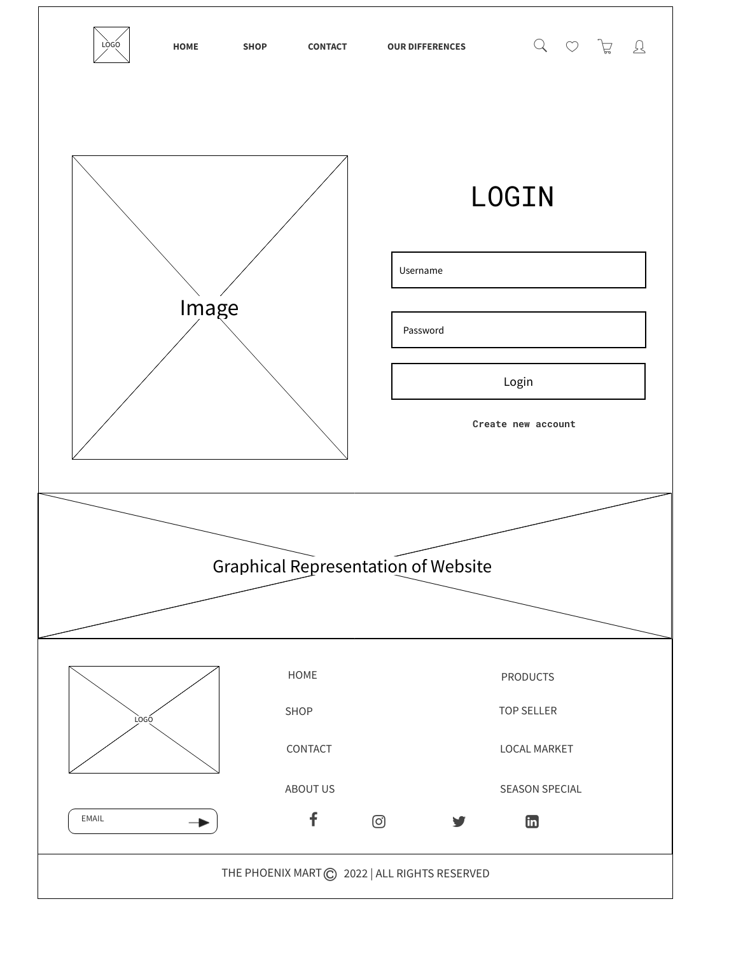
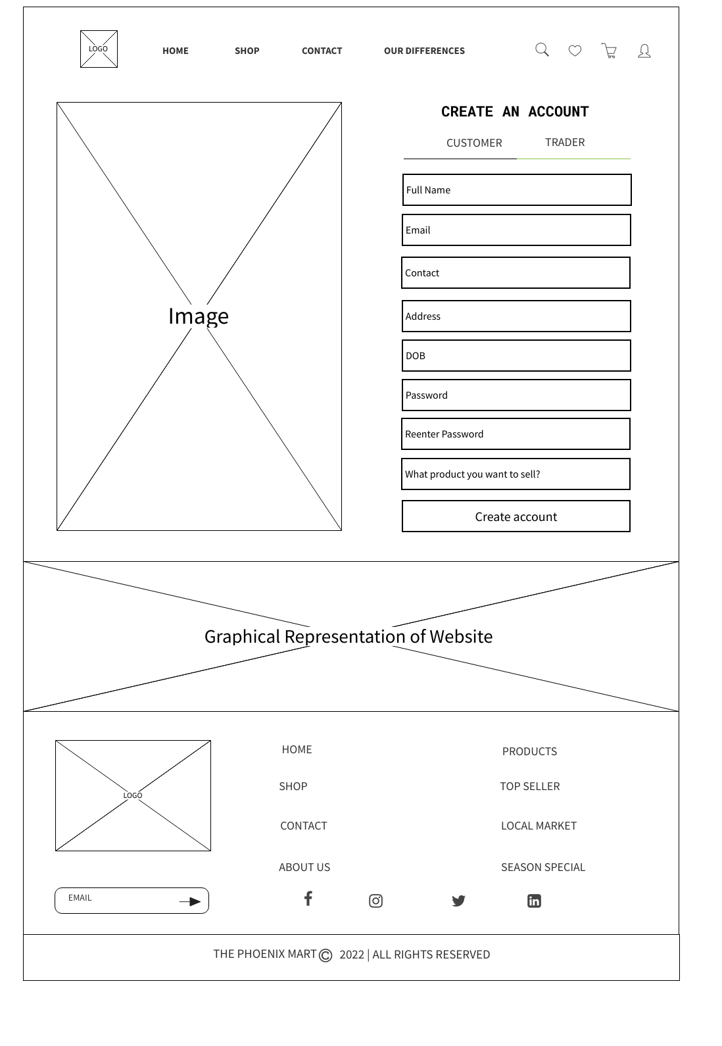
WIREFRAME DESIGN
Login Page
Signup Page

Slide 53
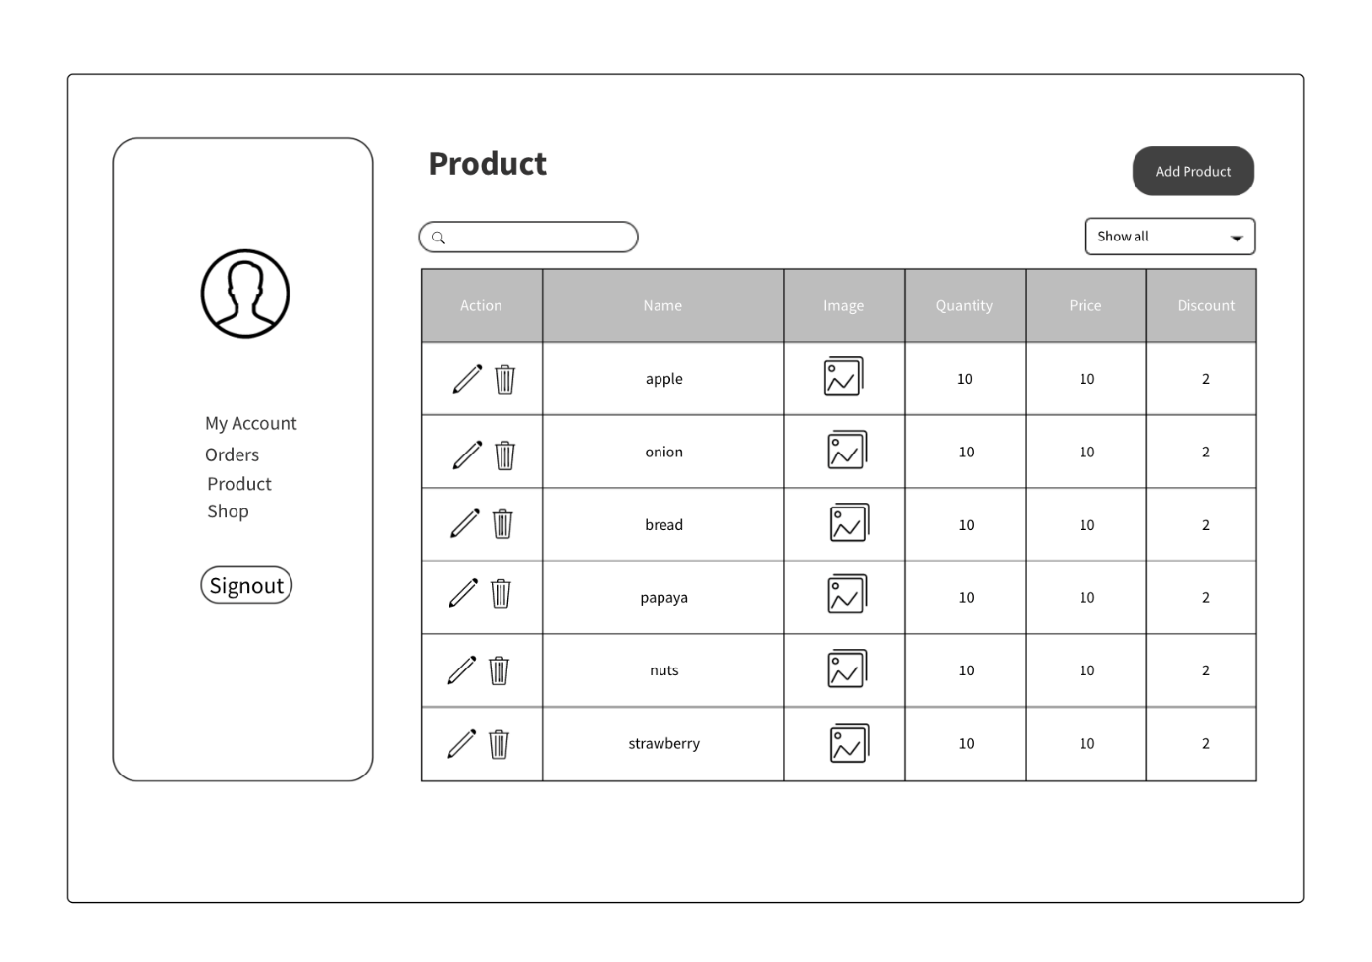
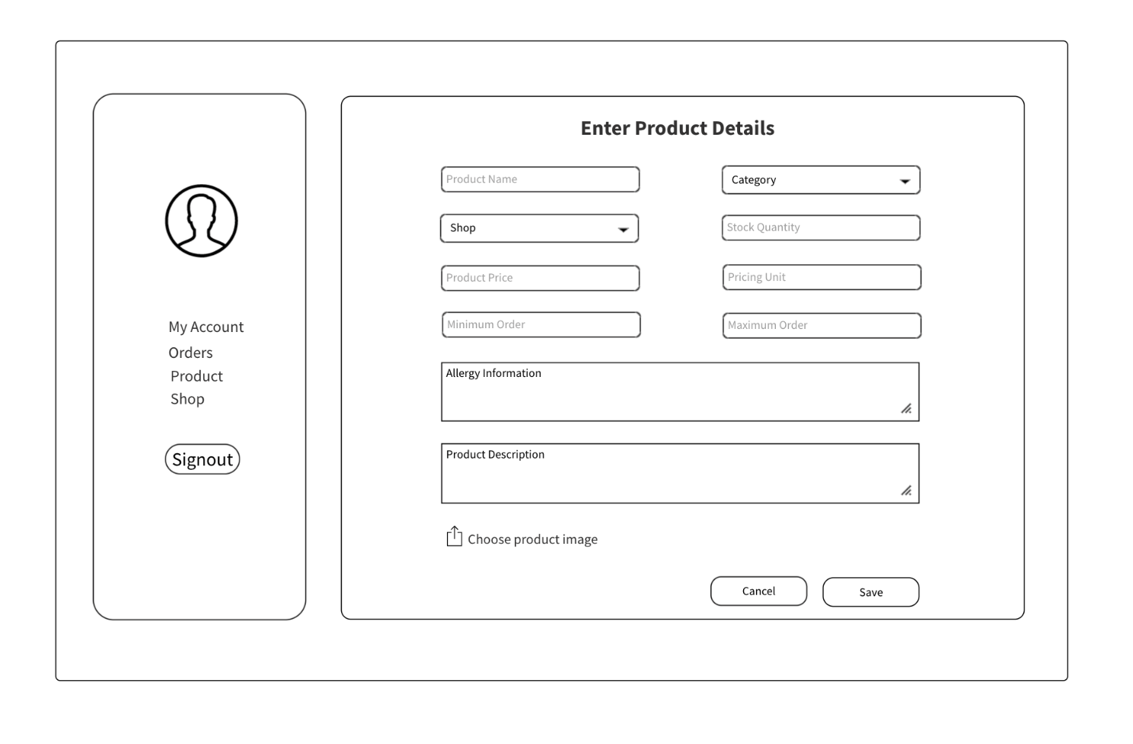
WIREFRAME DESIGN
Add Product Page
Product Page

Slide 54
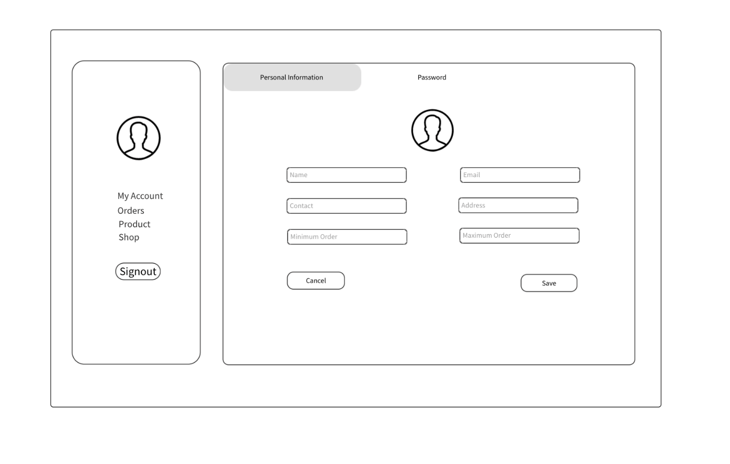
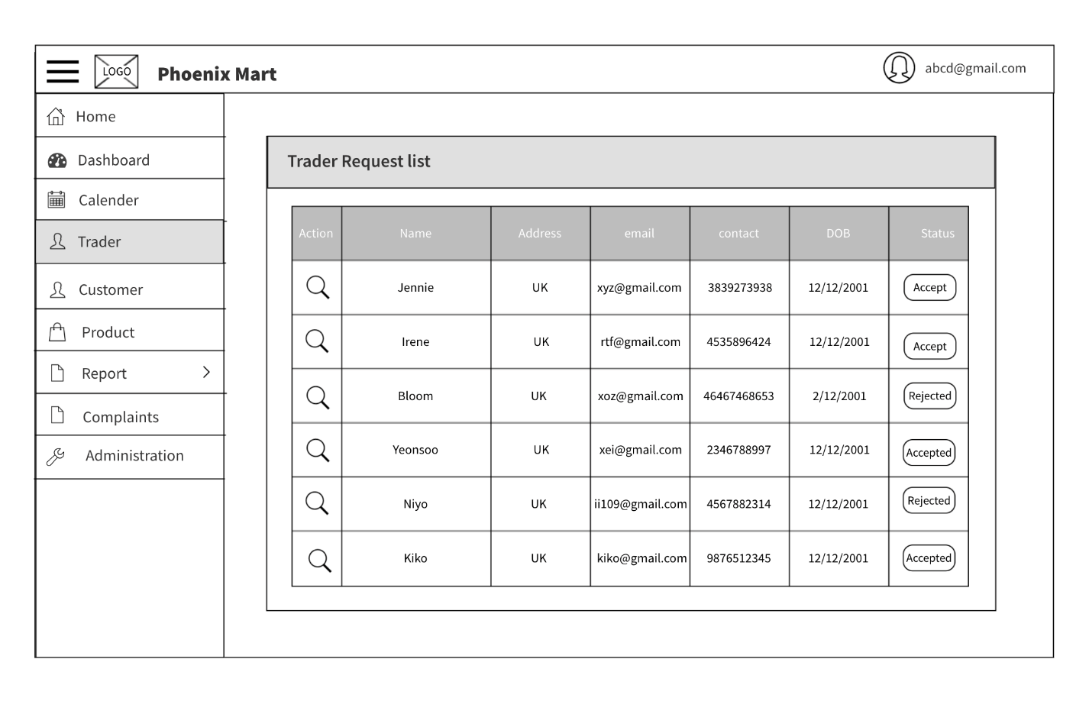
WIREFRAME DESIGN
Trader Profile Page
Add Trader Page

Slide 55
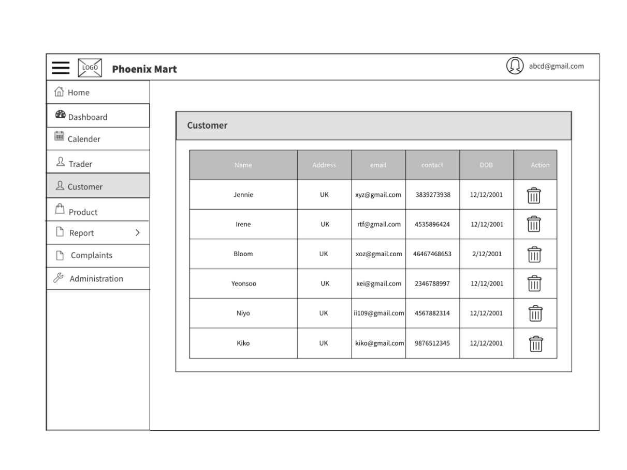
WIREFRAME DESIGN
Add Trader Page
Customer Detail Page

Slide 56
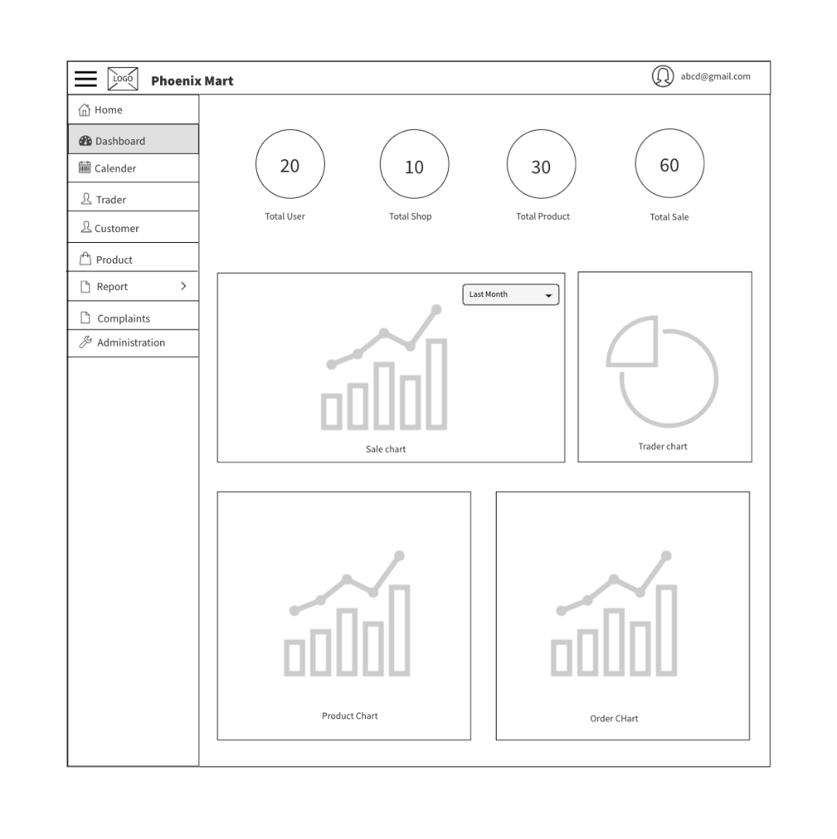
WIREFRAME DESIGN
Admin Dashboard

Slide 57
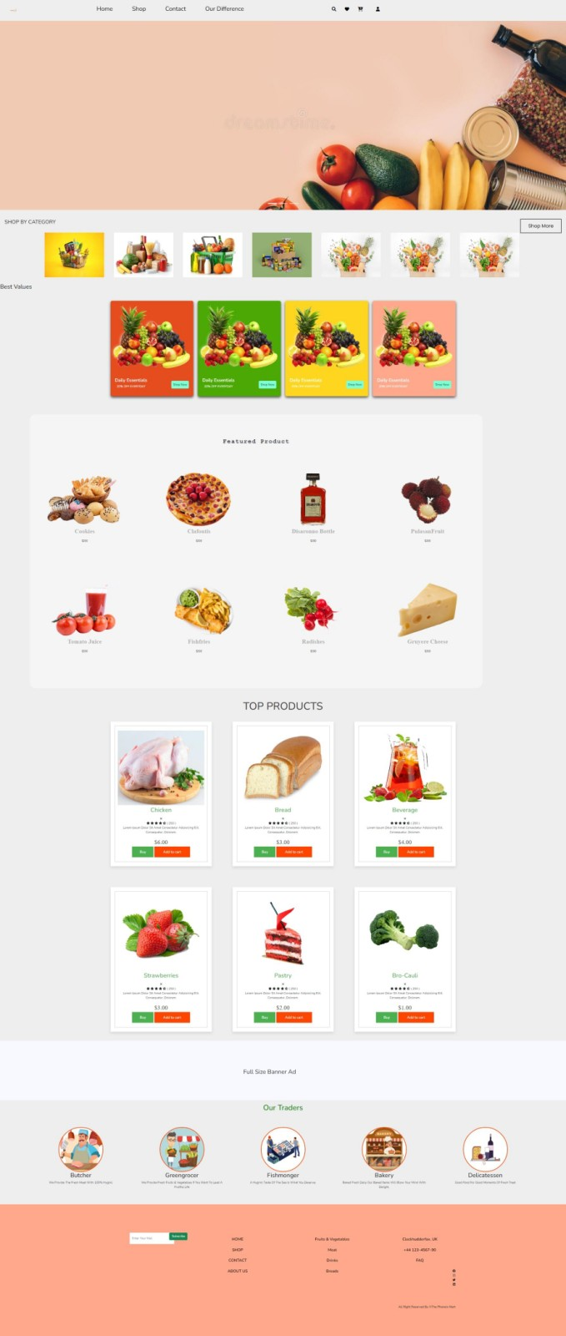

PRODUCT DEVELOPMENT
Homepage(Under Construction)
About Us (Under Construction)

Slide 58
THANKYOU

